Slide 1
Crescent Energy's Acquisition of Vital Energy
An Independent Technical Valuation from Public Data
~$3.15Bn
Independent PV-10 asset value (inc. G&A)
~$3.75Bn
SEC PV-10 (ex. G&A)
~$58-60/Bbl.
WTI Breakeven
Vandan Bhalala July 17, 2026

Slide 2
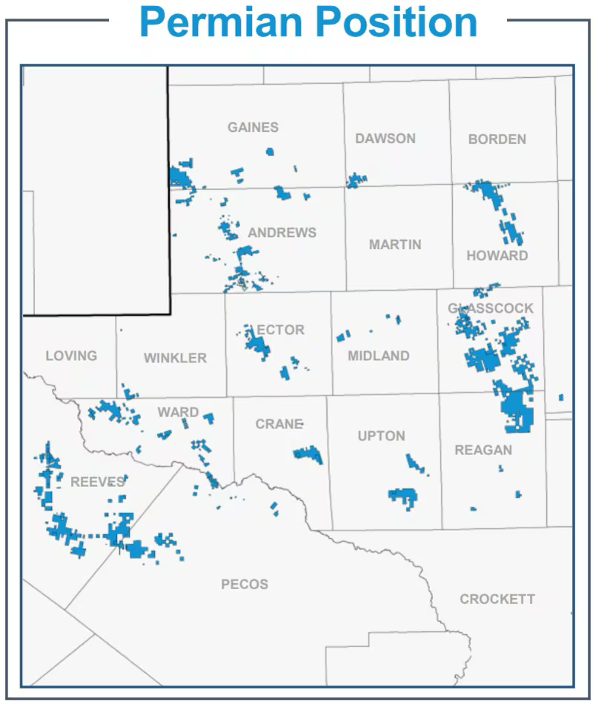
The Asset (Vital Energy)
Asset Details | Total Permian Basin
Net Acres⁽¹⁾ | ~286K
Estimated Proved Reserves⁽¹⁾ | ~455 MMboe
Reserves-weighting (%Oil) ⁽¹⁾ | 40%
Percentage Developed⁽¹⁾ | 70%
Average daily production⁽¹⁾ | 138 MBOE/d
Production-weighting Mix⁽¹⁾ | Oil 46% / NGL 27% / Gas 27%
Counties⁽²⁾ | Howard, Glasscock, Upton, Reeves, Ward
Production Split %⁽³⁾ | 37% (Delaware); 63% (Midland)
⁽⁴⁾
An oil-weighted Permian pure-play with 70% of reserves already developed, most of the value is producing today and not waiting on future drilling.
(1) Vital Energy Form 10-K. (2) Top 5 counties were considered for analysis.
(3) Author’s analysis.
(4) Crescent’s Permian Position.

Slide 3
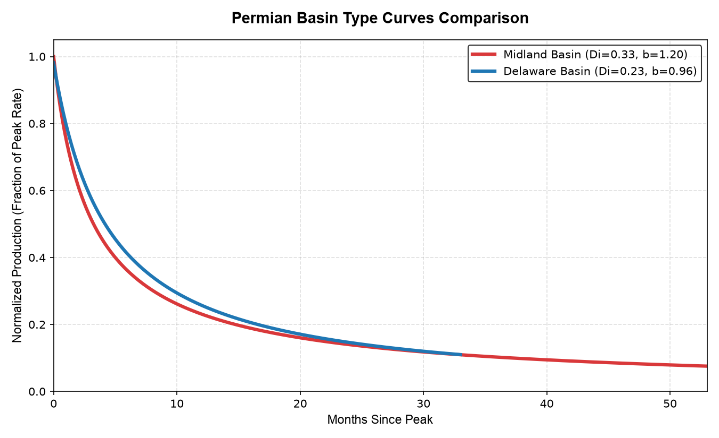
Technical Approach: Decline Curve Analysis on Public Production Data
1. Sourced production data from Texas RRC⁽¹⁾
2. Screened 100 top leases across 5 counties⁽²⁾
3. Fit Arps decline curves by basin⁽²⁾
4. Forecast 15-yr production by basin⁽²⁾
Result: two basin specific decline profiles (Midland declines faster and early, Delaware more durable) validated at R² 0.96 median.
(1) RRC Texas Production Data Query
(2) Author’s Analysis

Slide 4
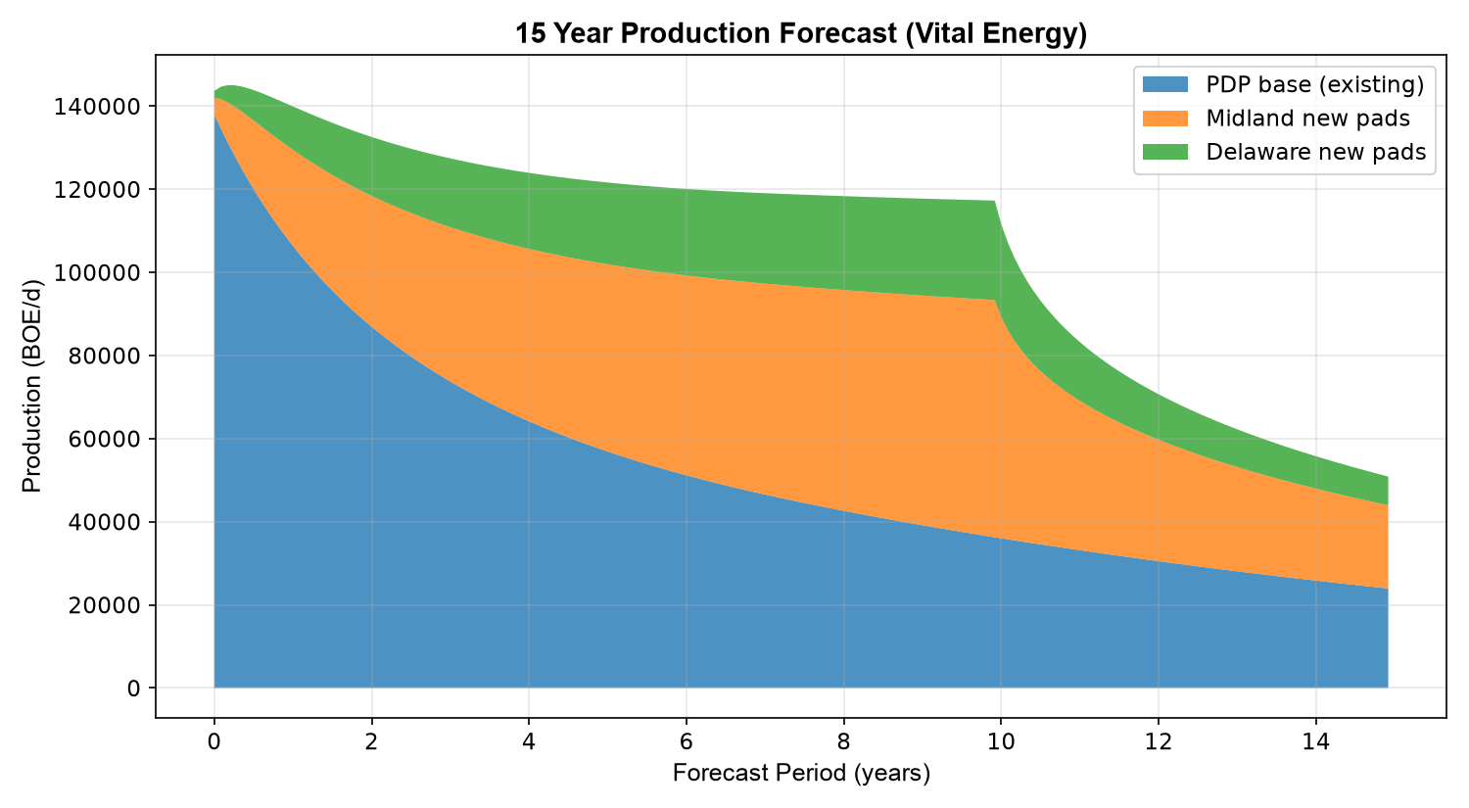
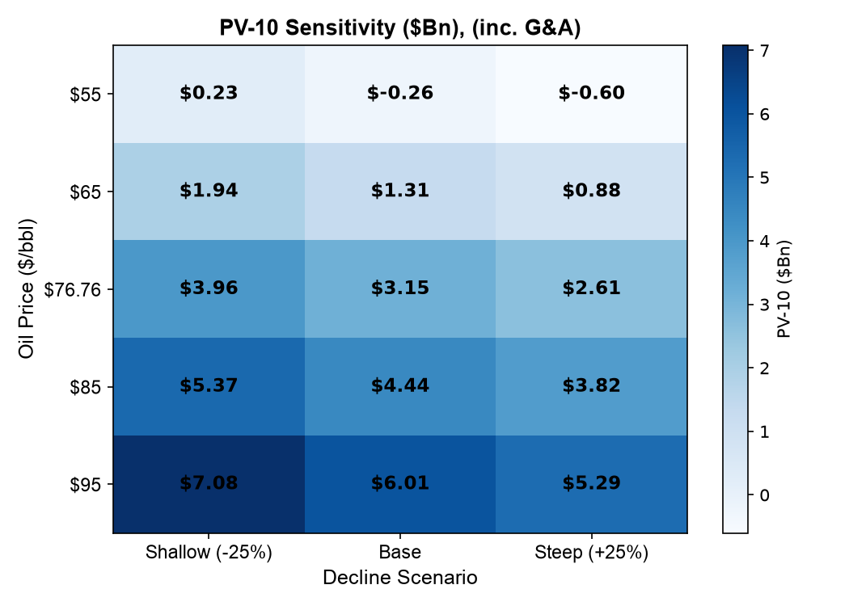
Valuation: PV-10 of $3.1B ⁽²⁾, In Line with Price Paid
Production Forecast
EBITDA $25.78/BOE⁽²⁾
Revenue $40.37/BOE⁽²⁾
~$475MM
Year 1 (Net Operating Cash Flow)⁽²⁾
PV-10 $3.15Bn⁽²⁾
PV-10 asset value of $3.15Bn⁽²⁾ (inc. G&A) lands within ~1% of the $3.1Bn paid. Stripping corporate G&A (SEC PV-10 convention) raises asset value to $3.74Bn⁽²⁾; the ~$600MM difference approximates the capitalized cost of Vital's standalone overhead, which aligns with the corporate synergies Crescent expects to capture by removing duplicate G&A.
(1) Vital Energy Form 10-K
(2) Author’s Analysis

Slide 5
Key Takeaways
My independent valuation puts Vital Energy’s assets at a PV-10 of $3.15Bn⁽¹⁾ (inc. G&A) within ~1% of the ~$3.1Bn Crescent paid. The deal was priced fairly on the rocks.
Value creation is financial, not a distressed asset discount, the market priced Vital Energy’s balance sheet, not its rock quality.
$90-100MM annual operating synergies⁽²⁾
400-450 bps refinancing benefit (Vital's expensive debt at Crescent's lower cost of capital) ⁽²⁾
~$1Bn non-core divestiture pipeline to accelerate deleveraging ⁽²⁾
Confirmed post-close: Crescent reported the transaction accretive across all key metrics (Q4 2025 earnings), consistent with this analysis.
Built entirely from public data (Texas RRC ⁽³⁾, SEC filings ⁽⁴⁾) using Python and Excel and performed decline curve analysis, type curves, reserve-based DCF, and sensitivity modeling.
(1) Author’s Analysis
(2) Crescent Energy to Acquire Vital Energy
(3) RRC Texas Production Data Query
(4) Vital Energy Form 10-K

Slide 6

Appendix
Takeaway:
Excluding corporate G&A per standard SEC PV-10 rules yields a baseline asset value of $3.75Bn, revealing ~$600MM in latent asset worth above the $3.1Bn transaction price. On an unburdened basis, the underlying reserves maintain positive asset economics down to ~$50–52/bbl. WTI.

